Slide 1

THE GOVERNMENT

Slide 2
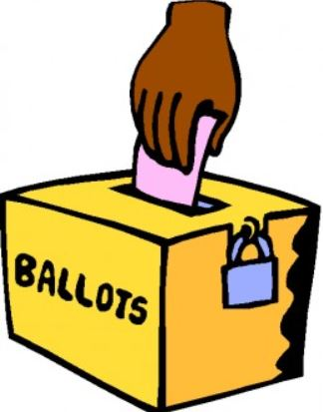
MEANING OF GOVERNMENT
DEFINITION:
A government is a group of people who govern the citizens of a country, they are responsible for running the country and making policies and passing laws
The Government of South Africa are elected democratically
Democracy:
When all the people in a country can vote for their government presentation

Slide 3
LEVELS OF GOVERNMENT
NATIONAL GOVERNMENT
PROVINCIAL GOVERNMENT
LOCAL GOVERNMENT

Slide 4
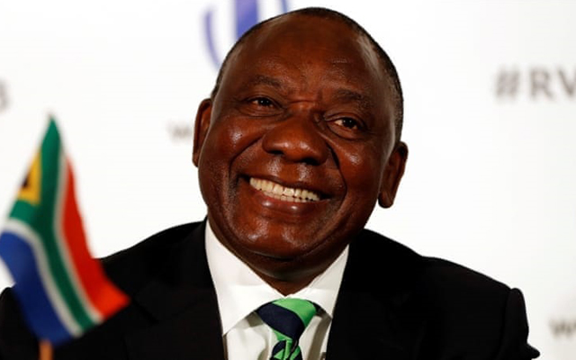
NATIONAL GOVERNMENT
Operate in the Top level
Make sure the State runs efficiently
Makes up laws that affect the whole country
Make citizens obey the State Laws
President is the Head of State
Current President is Cyril Ramaphosa
The president appoint deputy ministers
Ministers form the cabinet

Slide 5

Two houses of NATIONAL GOVERNMENT
NATIONAL ASSEMBLY
(FUNCTIONS OT THE STATE)
NATIONAL COUNCIL OF PROVINCES (LEVELS OF THE STATE)
Divided into three branches:
Legislative (Cabinet)
Executive (Parliament)
Judicial (Supreme Court)
They make the Governments job easier
Appoint a Provincial Government for every province
Appoint the Premier of every Province
Provincial Governments must report back to the NCOP

Slide 6
National assembly: function 1:
Cabinet/legislative
It makes the laws and policies of the country
It consists of the South African Parliament
President is the head
Day to day activities to run the country

Slide 7
National assembly: function 2: executive/Parliament
It has the power to execute or carry out laws
It leads the country and consists of the President, Deputy President and Ministers
Meetings take place in Cape Town.
Consists out of 2 houses:
  National Assembly (NA)
  National Council of Provinces (NCOP)

Slide 8
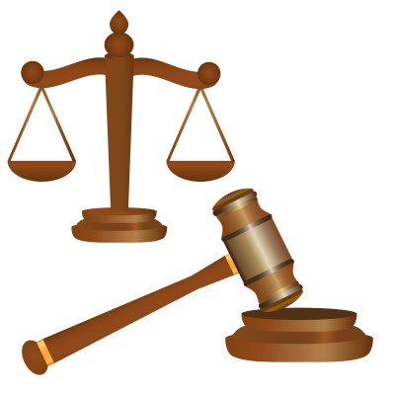
National assembly: function 3:
Judiciary/laws
It ensures that justice is served if people break the laws that Parliament makes
Made up of four tiers of courts
  Magistrates Court – minor crimes
  High Court – civil and criminal crimes
  Supreme court of Appeal – final court of appeal not involving the constitution
  Constitutional Court – final court of appeal involving the constitution

Slide 9

Level 1: NATIONAL GOVERNMENT
Provide for a stable set of institutions and rules
Make and control laws
Protection: defence, police and correctional
services
Education: Basic and higher Education and
training
Administrative: control of Economic activities,
foreign affairs and judicial
Economic: improvement of agriculture, mining,
trade, industries and transport services
National Budget by the Minister of Finance

Slide 10
LEVEL 1: PROVINCIAL GOVERNMENT:
The second level of management
9 Provincial Governments
Elected every 5 years
Head of each province is called a Premier.
Appointed by the president
Followed by MECs
Each member must manage a department
MECs:
Members of the Executive Council.
Are in charge of certain portfolios

Slide 11

PROVINCIAL GOVERNMENT services
Health services and welfare (Hospitals and Clinics)
Conservation of nature and the environment (protection of coastal resources and environmental education)
Administrative services ( payment of pensions and other social grants)
Providing a cultural infrastructure (subsidizing theatres, art galleries and performing arts
Construction and maintenance of
provincial roads
Building of schools, provision of
educators, textbooks and stationary

Slide 12

Level 3: LOCAL GOVERNMENT
Consists of over 280 municipalities
Provide a democratic and accountable government for local communities
Ensure that services are provided to communities
Promote social and economic development
Responsible for local:
roads
traffic
clinics
libraries
sewage
water & electricity
transport

Slide 13
LOCAL GOVERNMENT:
Municipalities
Metropolitans
Called uni- cities or metros
District
Runs affairs of areas where the population in scattered
Local
Runs affairs of smaller towns
Run the local affairs of SA’s largest cities

Slide 14

The 8 Metros:
Buffalo City (East London)
City of Cape Town
Ekurhuleni (East Rand)
City of eThekwini (Durban)
City of Johannesburg
Mangaung (Bloemfontein)
Nelson Mandela (Port Elizabeth)
City of Tshwane (Pretoria)

Slide 15



Government income:
Income tax
Levies (eg VAT)
Duties (eg Customs duties)

Slide 16
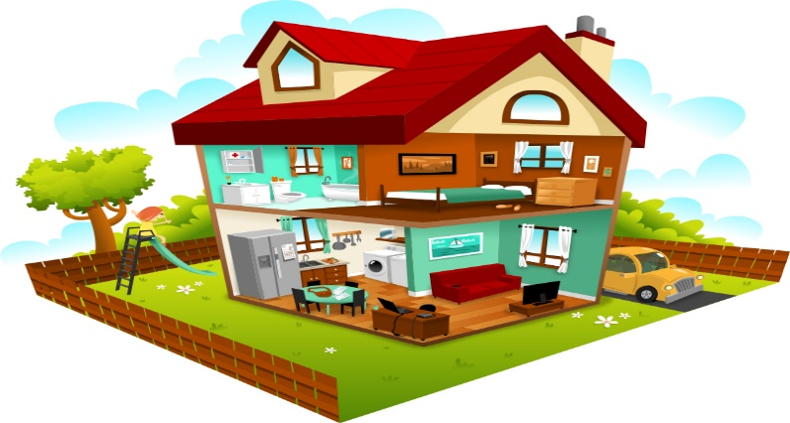

Government interact with this two roleplayers:
HOUSEHOLDS
BUSINESS
Means all the people living together in a house.
Households own the factors of production
Provide services
Households pay taxes.
All levels of government are consumers.
They are also producers
Businesses are consumers because they pay for certain services.
They also pay tax to the government

Slide 17
Households use services and provide resources:
Services:
Resources:
Education
Hospitals
Sport and recreation facilities
Help people with
Disabilities
Safety
Water and sanitation
Electricity
Workers, buildings
Workers, buildings, medicine
Infrastructure
Social grants
Police, military and correctional services
Infrastructure, workers, land
Infrastructure , workers, machinery

Slide 18
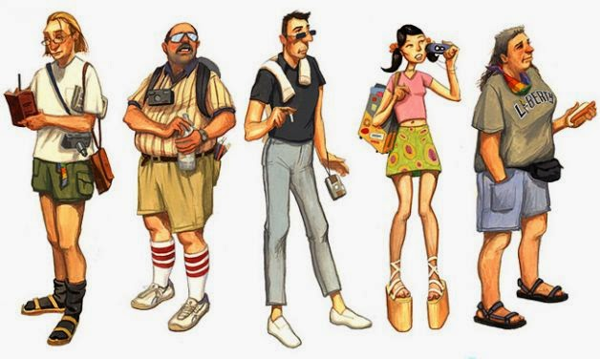
The role the government plays regards to Businesses
Services
Resources
Provide electricity, water
and waste removal
Promotes tourism
Encourages business development
Promotes international trade
Ensure good roads
Promotes tourists to visit
Getting involved in farming, forestry and fishing
Encourage production of goods and services

Slide 19

Laws to protect the rights of workers
Basic Conditions of Employment Act
This law sets minimum employment standards for employers and employees
Labour Relations Act
This law protects workers or people looking for employment against unfair labour practices and allows workers to join trade unions
Employment Equity Qct
This law protects workers against unfair discrimination and ensures that businesses employ a workforce that is representative of the population

